Slide 1
‘Working Title’
Production Designer: [NAME]

Slide 2
Schedule

Slide 3
Key Dates
Activity | Date
Pre-production starts
Set build at location starts
First day principal photography
Block 1 ends
Block 2 starts
Block 2 ends
All sets and props to storage / recycling

Slide 4
Who’s in the team?

Slide 5
Production Designer
Supervising Art Director
Senior Draughtsperson
Art Dept Co-ord
Stand-by Art Director
Graphic Designer
Set Decorator
Production Buyer
Set Dec Assistant(s)
Riggers
Carpenters
Plasterers
Painters
Junior Draughtsperson
Construction Manager
Supporting the Art Department
Art Dept Asst
Runner(s)

Slide 6
Mood Board Interior: Classroom

Slide 7
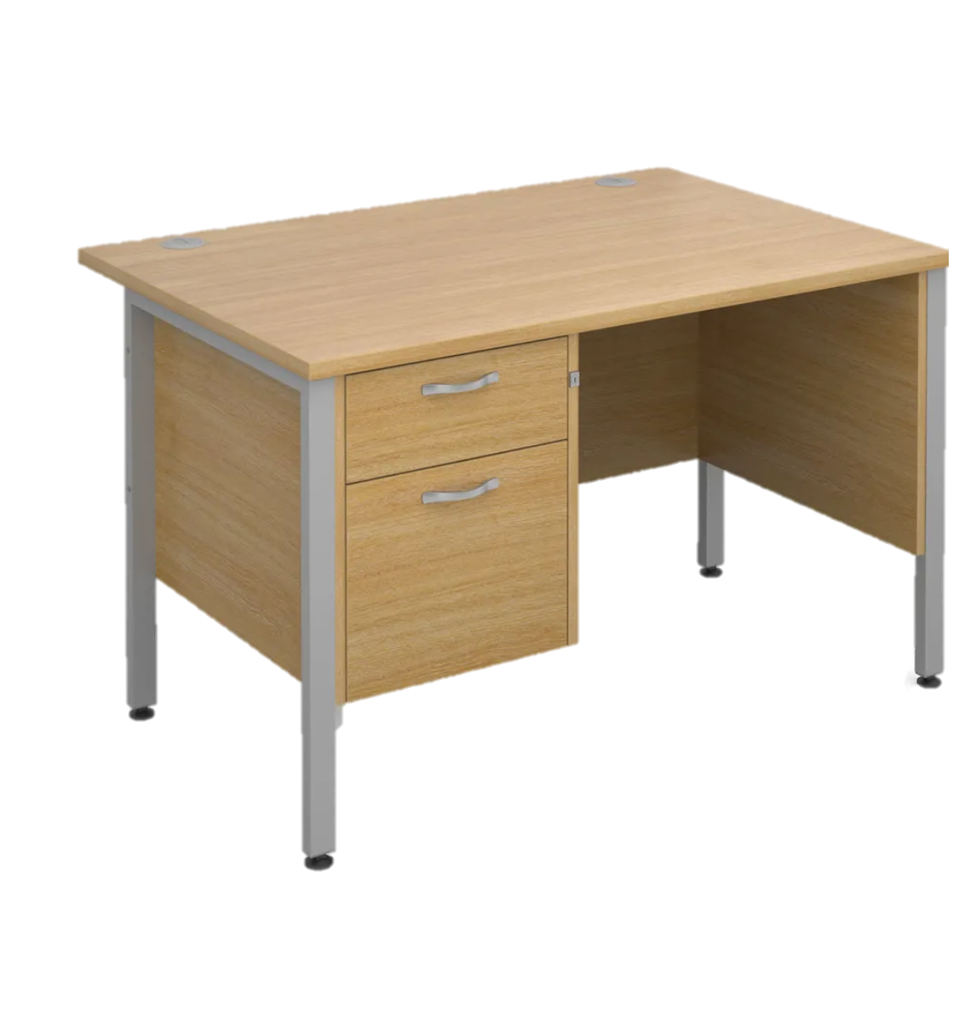
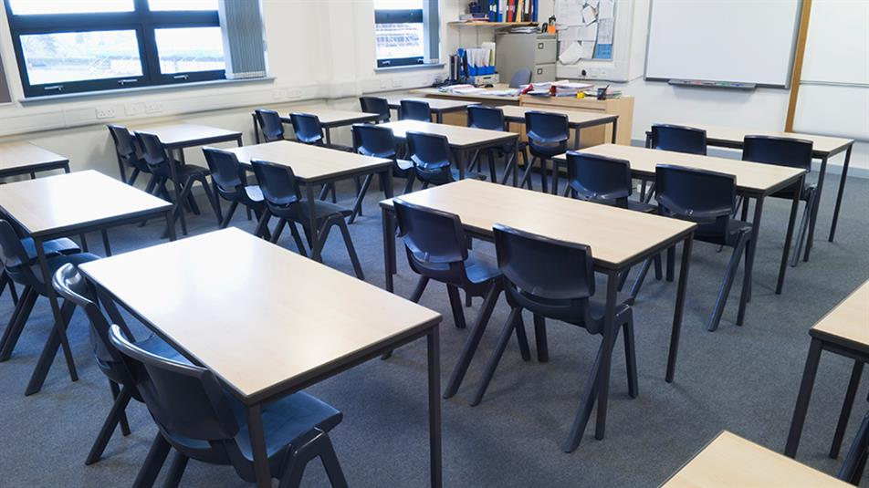
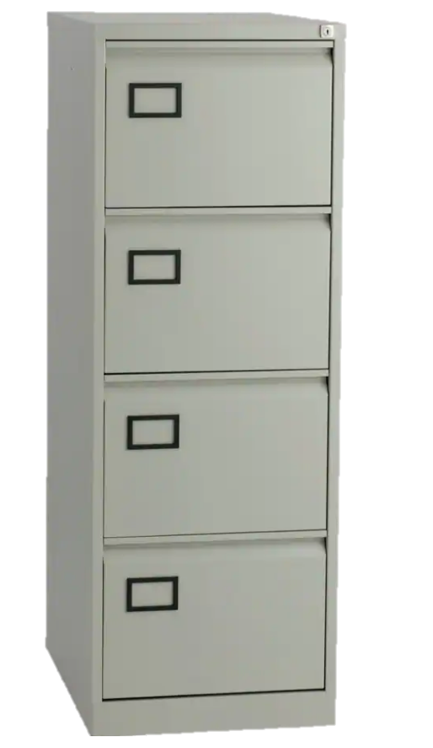
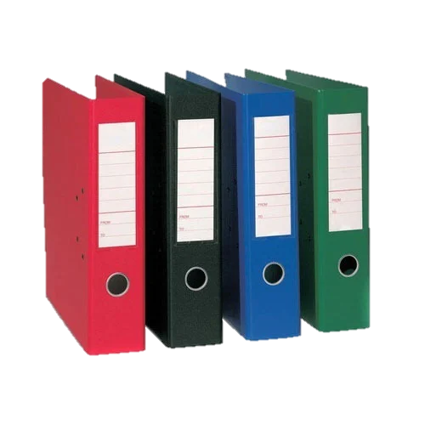
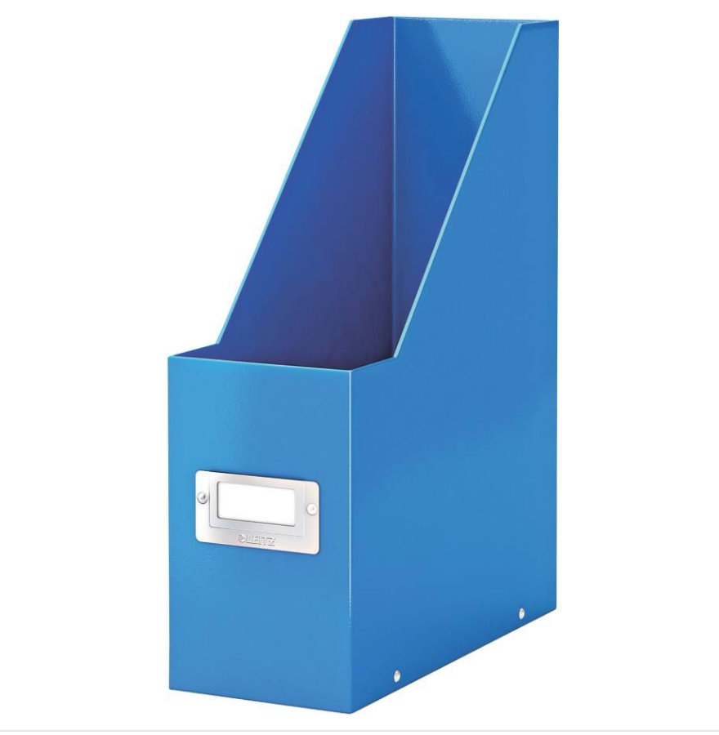
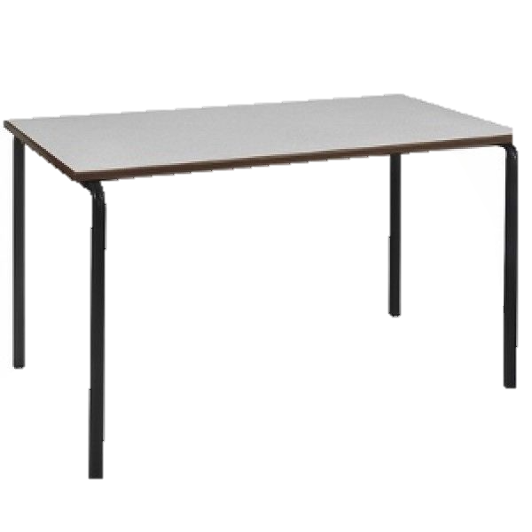
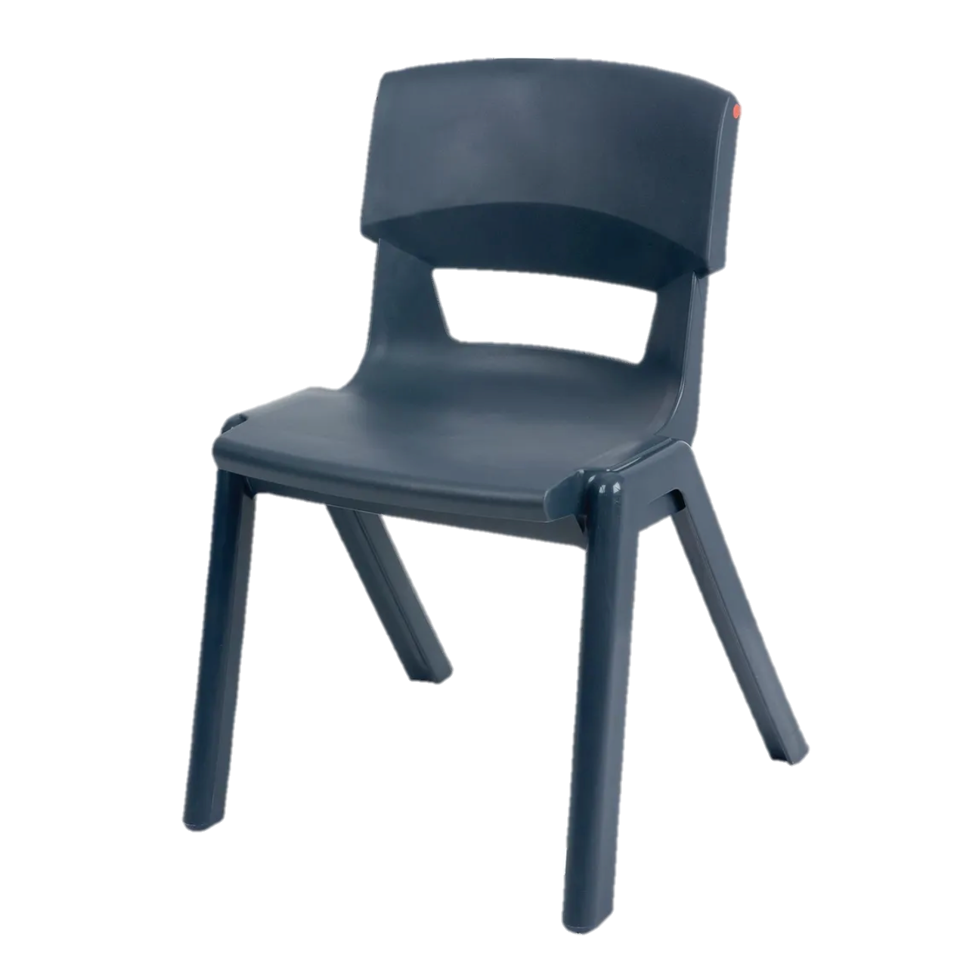
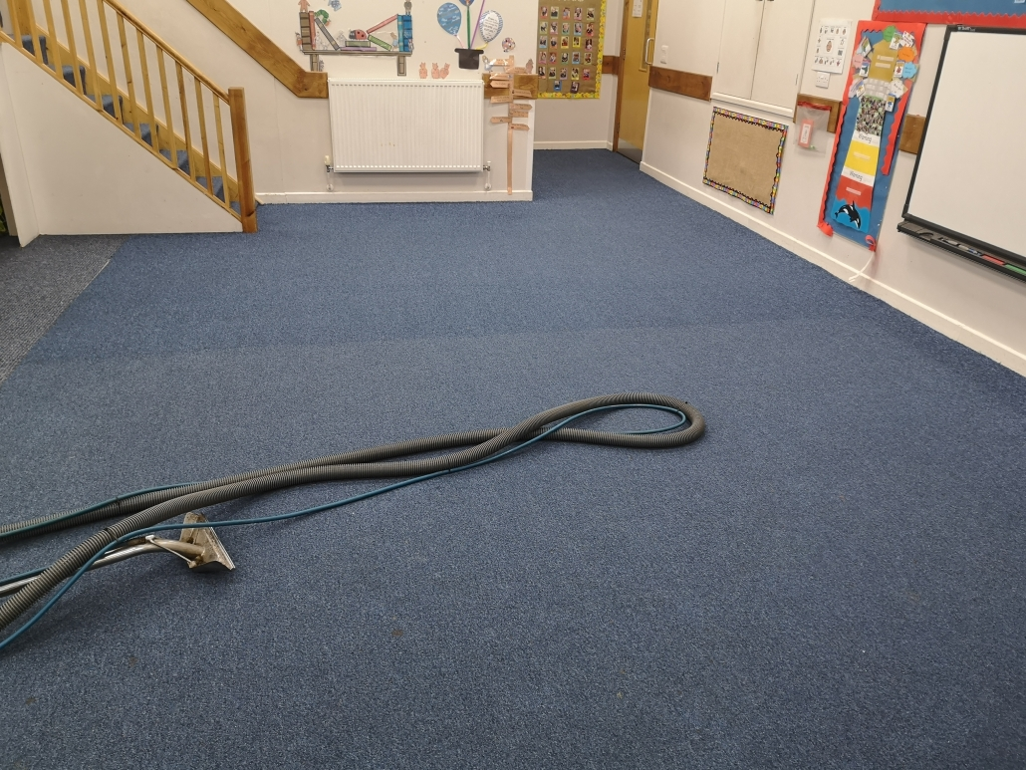

Slide 8
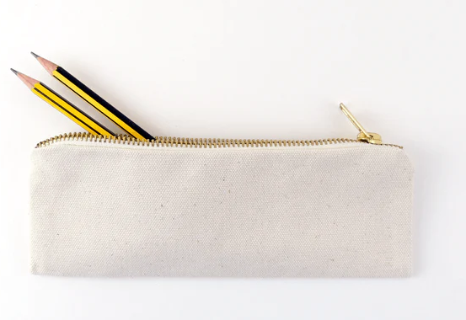
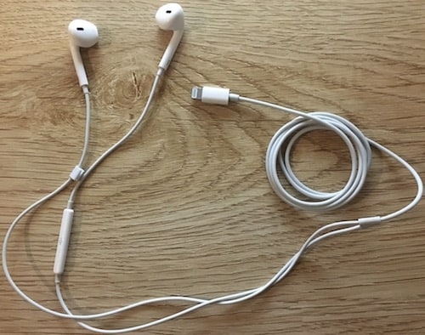
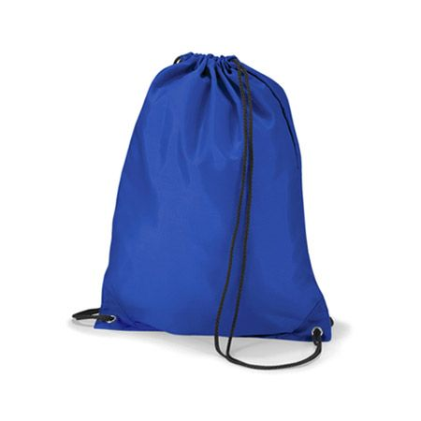
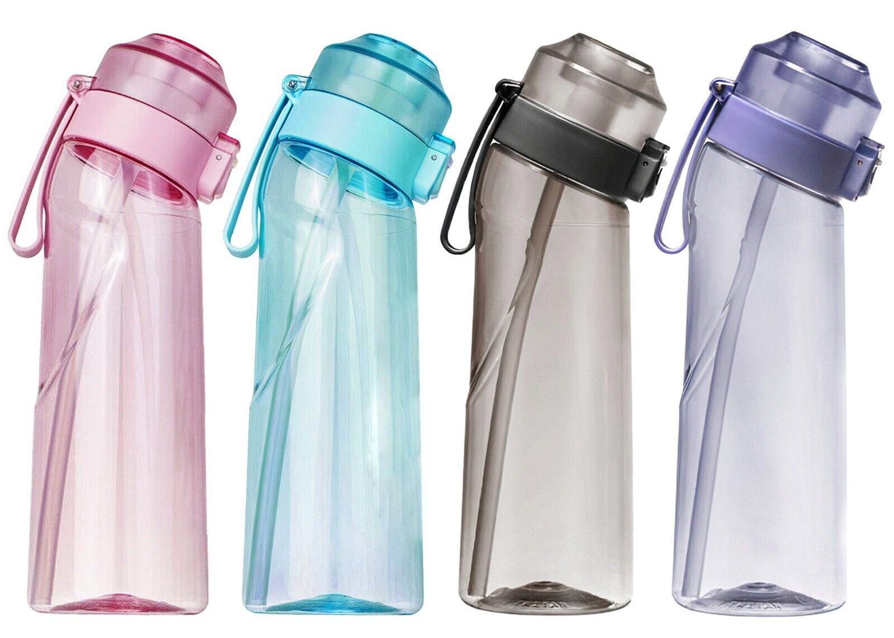

Slide 9
Mood Board Interior: Tweenager Bedroom

Slide 10
Tweenager Bedroom

Slide 11
Video references

Slide 12
Video linked from YouTube
https://www.youtube.com/watch?v=lklSKXXYvU0

